Slide 1
Statewide Integrative Medicine Collaborative
Report of Introductory Survey
February 2016
Tracey Sondik, Cheryl Stockford

Slide 2
Collaborative Purpose
To further the department’s commitment to providing person-centered approaches which are grounded in science.
To promote and coordinate statewide integrative medicine activities within Connecticut’s behavioral health service system.

Slide 3
Survey
Disseminated to all respondents registering to attend initial meeting
Respondents are those who are committed to integrative medicine or, who have a strong interest in utilizing integrative medicine and other holistic practices that are grounded in research (yoga, mindfulness, acupuncture, reiki, tai chi, etc.)

Slide 4
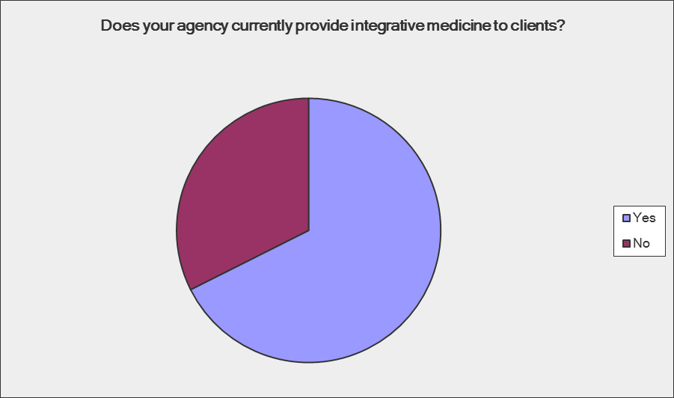
Agencies currently providing integrative medicine
Answer Options | Response Percent | Response Count
Yes | 67.6% | 23
No | 32.4% | 11
answered question |  | 34
skipped question |  | 0

Slide 5
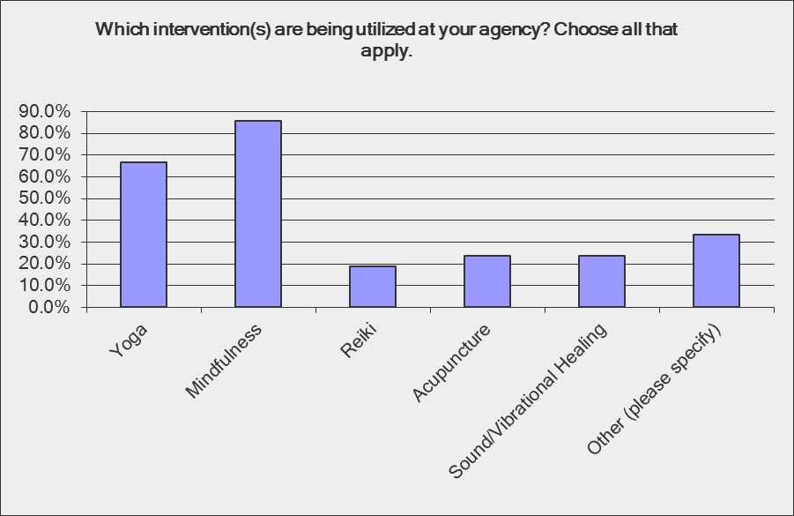
Intervention(s) Utilized at Agencies
answered question | 21
skipped question | 13

Slide 6
Other reported intervention(s) being utilized at respondent agencies
Guided imagery, meditation. Exposure to all; none permanently in place.
Tai chi, pet therapy, comfort rooms
Comfort room, pet therapy
Pet therapy
Meditation
Tai Chi/Drumming
Primary care

Slide 7
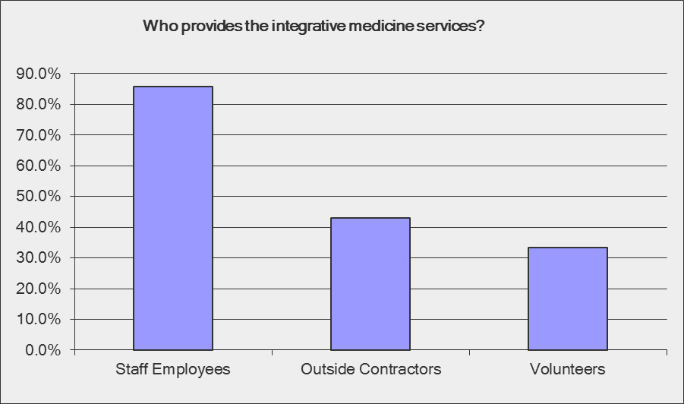
answered question | 21
skipped question | 13

Slide 8
What are the specific client population(s) that are offered these services?
Answer Options | Response Percent | Response Count
Mental Health | 95.2% | 20
Substance Use | 85.7% | 18
Primary Care/Prevention | 23.8% | 5
answered question |  | 21
skipped question |  | 13

Slide 9
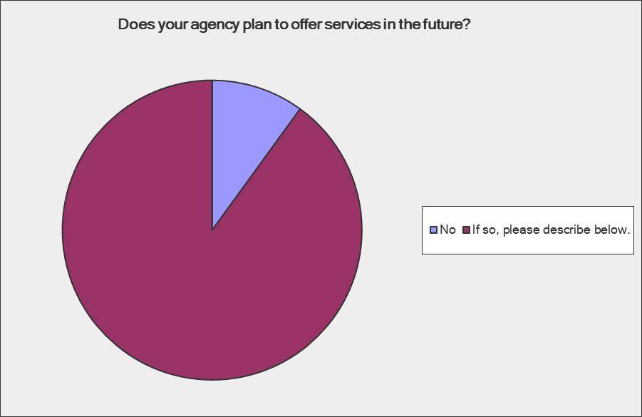
We are beginning to offer mental health clinical services (1:1 and group therapy) and will expand into prescribing shortly. Once that is established, we hope to explore having a naturopath contract with us and further expand into primary care services.
There is interest in the development of yoga and mindfulness practices for trauma survivors.
Yes. Enfield Youth Services is looking toward providing mindfulness and yoga programs/services to the schools/community.
WE are a monitoring reporting and coordinating agency - therefore we work with many different programs in the community. We would like to be able to promote integrative medicine interventions in the areas that we serve.
Recently approved to hire a medical APRN.
not sure - I would like the agency to do this
We will continue to assess as the models for healthcare delivery services and the reimbursement evolve.
We have had weekly meditation and twice a week yoga in our residential SA program, but have drifted off from it due to staffing changes. We would like to reestablish these services.
Yoga, Meditation and will explore other options.

Slide 10
Are there opportunities for staff to attend trainings, workshops, and obtain certification in integrative medicine (e.g. DMHAS Education and Training, Women's Consortium, outside training)?
Answer Options |  | Response Percent | Response Count
No |  | 17.2% | 5
Is yes, please describe. |  | 82.8% | 24
answered question |  |  | 29
skipped question |  |  | 5

Slide 11
Accu-Detox, TM. This has primarily been individually driven in the past with varied degrees of support.
Integrative medicine lectures, DMHAS ED and Training , Outside training
GBCMHC is involved in the Trauma Initiative through the Women's Consortium. Outside speakers have presented in Grand Rounds and there is support for attending other trainings and workshops.
Both in house and at Women's consortium, but not usually front line nursing staff
Yes. In fact our agency director has just purchased a webinar training for our entire staff and invited guests to be a part of. Mindful Play & Meditation for Anxiety & Depression.
trainings are highly encouraged and there is consideration for further certification training i.e. yoga
mindfulness, meditation, yoga, mind body connection
Staff are required to maintain appropriate licenses so we encourage staff to attend programs that they are interested in and support professional development.
All staff have training days available to them. Agency is motivated to grow further in this area
Due to budget considerations we have a freeze on any trainings which have a cost associated with it.

Slide 12
Preliminary planning agenda items for this state-wide collaborative includes development of an annual conference, increasing integrative medicine service delivery for clients, staff competencies in integrative medicine, and research opportunities. Are there any other planning items that you would like to see included?
My areas of expertise are teaching mindfulness based stress reduction and doing Somatic Experiencing Trauma Healing in Spanish and English

Slide 13
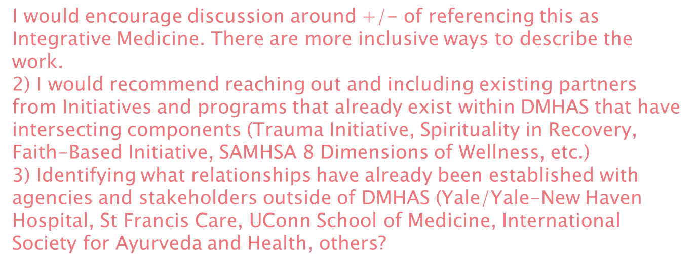
The actual development of the committee as to who will be actually on it, whose still needed and the chain of command.
Exploring alternative therapies in conjunction with traditional medicine
More training opportunities for acupuncture

Slide 14
I'm interested to learn more about funding for these additional services especially in the current fiscal environment.
I would like to see the application of these services to trauma survivors and care givers.
Clients involved in planning conference and also included in the invitation list
knowledge exchange
Self care for staff utilizing mindfulness
Wondering if there would be any small funding opportunities to grow these programs in our agency. Right now we have volunteers…also looking into the future, ability to bill for yoga, etc. groups.

Slide 15
Reimbursement
Best Practice regarding the health and well being of the population treated at our agency. Chronic illness/Trends based on geographic location
Outcome expectations

Slide 16
Respondents’ Reported Job Titles
Nurse Practitioner Consultant - MBSR
Director of Integrated Health and Wellness
Dental Director
Chief Operating Officer
Chief of Behavioral Health
COO
Psychologist
Director of Recovery University
Director of Community Support Services
Supervising Psychologist
BH Clinical Manager
Clinician
Youth Conselor
Program Director Carnes Weeks Center

Slide 17
Clinical Director
Director, BHH
Outpatient Clinic Director
Lead Nurse Clinician
Director, BHH Initiative
Program Director
Senior Case Manager
clinician
Assistant Director, Business Affairs
Chief Operating Officer
Director of Behavioral Health Services
Integrated Care Supervisor
Director of Nursing
Director of Nursing
CEO
answered question | 29
skipped question | 5

Slide 18
health and there is a growing trend in utilizing integrative medicine in behavioral health settings to address mental health and substance use issues and improve clinical outcomes.
To further the department’s commitment to providing person-centered approaches which are grounded in science, a new Connecticut Statewide Integrative Medicine Collaborative is being convened to promote and coordinate statewide integrative medicine activities within Connecticut’s behavioral health service system.
I would like to invite those from your agency who are committed to integrative medicine or, who have a strong interest in utilizing integrative medicine and other holistic practices that are grounded in research (yoga, mindfulness, acupuncture, reiki, tai chi, etc.) to join me on Thursday, February 25, 2016 at 9:00 am, in Page Hall room 365 for our initial meeting.
The Collaborative will be co-facilitated by Cheryl Stockford and Tracey Sondik. Cheryl oversees the implementation of the department’s statewide behavioral health home initiative. Tracey is the director of behavioral services at CVH and co-chairs a CVH integrative medicine committee which has been active since 2010 and sponsors the highly successful annual health fair, trainings for staff, and individual and group interventions for CVH clients.
Anticipated commitment for the group will be quarterly meetings for 90 minutes at CVH. We ask that those interested in attending RSVP to Lisa Wolf (lisa.wolf@ct.gov or (860)418-6965)by 2/1/15 with their name, discipline, facility, contact information (phone number and email) and area of particular interest in integrative medicine, if known. We also invite you to share this email with others who may be interested in joining the integrative medicine collaborative.

Slide 19
Area of Interest
Mindfullness Based Recovery
n/a
n/a
n/a
Primary Care, BH & Addiction Recovery
Primary Care, BH & Addiction Recovery
n/a
BH integrated w/Primary Care
BH integrated w/Primary Care
BH integrated w/Primary Care
Interested in all areas
Torture Ttmt & Trauma Informed Care
n/a
n/a
Yoga, meditation & mindfulness

