Slide 1
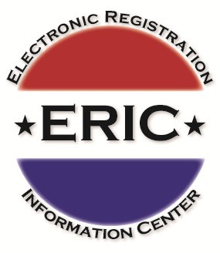
S
S

Slide 2
Today’s Agenda
Importance of an accurate list
Status report on ERIC
ERIC membership responsibilities for state and local elections officials

Slide 3

ERIC’s Mission
Assist states to improve the accuracy of voter rolls, reduce costs, and improve efficiency for state and local election offices.

Slide 4
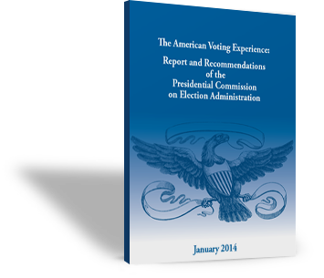

Presidential Commission Report
“The Commission endorses state programs to share data and to collaborate in the synchronization of voter lists so that the states, on their own initiative, come as close as possible to creating an accurate database of the eligible electorate.”
www.supportthevoter.gov

Slide 5
Why are accurate voter registration lists important?
“The quality of the list can affect the ability of people to vote, of election offices to detect problems, and of courts and others monitoring elections to detect election fraud or irregularities. A list with many incorrect records can slow down the processing of voters at polling places resulting in longer lines.”
PCEA Final Report, Pg. 22
Notes:
Slide 7 – ERIC’s Mission – 1 click
The workgroup began focusing on finding a way to better understand and use data to help improve the accuracy of our roles, reduce costs and provide efficiencies.
With Jeff Jonas, IBM Fellow and Chief Scientist, and Jeff Butcher, also with IBM, at the table, we focused using powerful – and proven – data matching tools already in use by the private sector.
Eventually, we developed what is now the Electronic Information Center, or ERIC.
We realized that not only would we have access to high quality data (the likes of which elections officials have never had access to before) to help clean-up our roles and keep them clean, but that we could also identify people in our state who are eligible to vote, but aren’t registered.

Slide 6
ERIC is self-governing and self-supporting
State-run, 15 states & DC
Incorporated May, 2012
Membership agreement
2 full-time employees
Routine uploads and reports
Recruiting new members

Slide 7
Where ERIC started in 2012
WA
ME
MT
ND
OR
MN
NY
ID
SD
WI
WY
MI
IA
PA
NV
NE
IN
OH
VT
IL
WV
NH
UT
CO
VA
CA
KS
MO
KY
MA
NC
RI
TN
CT
AZ
NM
OK
AR
SC
GA
NJ
MS
AL
DE
TX
LA
MD
FL
DC
AK
HI

Slide 8
ERIC in 2016 – Members in Green, States that have adopted legislation in Yellow
WA
ME
MT
ND
OR
MN
NY
ID
SD
WI
WY
MI
IA
PA
NV
NE
IN
OH
VT
IL
WV
NH
UT
CO
VA
CA
KS
MO
KY
MA
NC
RI
TN
CT
AZ
NM
OK
AR
SC
GA
NJ
MS
AL
DE
TX
LA
MD
FL
DC
AK
HI

Slide 9
ERIC Reports
Outreach
Eligible but Unregistered
List Maintenance
In-state Movers
Cross-state Movers
Deceased
In-state Duplicates

Slide 10
List Maintenance
In-state Movers
DMV or NCOA record with newer address
Cross-state Movers
Newer Voter or DMV or NCOA in another state
Deceased
Match to Social Security Death Master list
In-state Duplicates
Every one or two months, at least annually
Match only sent once
Possible actions:
  Send postcard to old address and act on undeliverable
  Voluntary cancellation request to new address
  Notice and inactivation if no response
  Depends on state laws

Slide 11
Outreach: Eligible but Unregistered
Minimum every two years
Contact voters within 90 days of report
ERIC only includes a name again if address changes
DMV
Voters
Notes:
DMV records with no voter counterpart
Cross-checks other state Voters
Added benefit of helping update rolls:
In 2012, states found incorrect birth dates and other information that kept records from matching. Once Washington State noticed the pattern of people calling in to say they should already be registered, they started keeping track. Just from calls to State Elections, they were able to correct over 1,100 records that ERIC was not able to identify due to a name or date of birth error.

Slide 12
March, 2016 report statistics
Report Type | 2015 Summary | Total Records Sent
In-state movers | 742,266 | 2,734,006
Cross-state movers | 269,824 | 614,405
Deceased | 61,278 | 145,657
In-state duplicates | 14,030 | 52,024
TOTAL | 1,087,398 | 3,546,092

Slide 13
March, 2016 report statistics
Report Type | Records Sent
Eligible but unregistered In DMV but not registered to vote | 11.7 million

Slide 14
Reports Sent from ERIC to Connecticut
Eligible but Unregistered | 2014
In DMV but not registered to vote | 814,029
List Maintenance | 2015 | 2016 | Total Records
In-state movers | 8,936 | 16,540 | 25,476
Cross-state movers | 4,317 | 3,136 | 7,453
Deceased | 4,172 | 1,420 | 5,592
In-state duplicates | 1,536 | 1,182 | 2,718
TOTAL | 18,961 | 22,278 | 41,239

Slide 15
Membership Agreement
Data
Send VR and DMV data every 60 days
Each state must act on reports within 90 days of receipt
Reporting
Online versus paper registration statistics
Must order list maintenance reports once every 365 days
Eligible but Unregistered report before each Federal General
Suggest moving list maintenance to monthly routine
Provisional ballot statistics
Unregistered outreach
Election day activity

Slide 16

Membership Agreement - Privacy
Reports are to be used only for VR purposes
Reports are to be kept confidential
SSN & DOBs are anonymized
Most sensitive data: Anything from DMV
State must immediately disclose unauthorized release of data

Slide 17
Membership Agreement – Security Policy
Any requests for copies of ERIC data should be reported immediately to the Connecticut Secretary of State.
Accidental or purposeful release of data could be grounds for legal action under the Drivers Protection Policy Act.
A release of data must be immediately disclosed to the SOS.

Slide 18
ERIC staff
John Lindback, Executive Director
Ericka Haas, Systems Engineer and Technical Liaison to the states
Website: www.ericstates.org

