Slide 1
New Registrar of Voters
ENDORSEMENTS
State and Municipal
Major and Minor Parties

Slide 2
What you absolutely need to know
Where is the election calendar: On our web page
  Select Elections – Go To Election Officials – Calendars Current & Archive
Municipal endorsements: CGS § 9-391
State endorsements: CGS § 9-388
Minor party endorsements: CGS § 9-452
Read the monthly mailings you receive from our office

Slide 3
Municipal (Odd Numbered Years)
Forms created by Town Committees – The Town Clerk will provide the town committees with a list of offices that will be on the ballot.
Endorsement Forms filed with Town Clerk – After the town committees file their endorsement forms, the town clerk can create a list of candidates.
Endorsement Period – See the Election Calendar for the exact dates !!
  Municipal offices fifty-six to forty-nine days before the primary (CGS 9-391) = 7 day window
Requirements:
  Certified to the Town Clerk by the chairman, presiding officer or secretary of the town committee;
  Candidate’s name and address;
  Office and if applicable political subdivision or district;

Slide 4
Minor Party Municipal
What is a minor party? Not a major party (Democratic or Republican) who has obtained 1% of the total numbers of votes cast for an office in the prior election for that office.
Forms created by Minor Parties
Forms filed with Town Clerk
Requirements – CGS 9-452
  Title of office and district;
  Candidate’s name as authorized by each candidate to appear on the ballot;
  Signature of candidate accepting the endorsement;
  Full street address;
  Certified by presiding officer of the committee, meeting or other authority making such nomination.
  Nominations to be filed not later than the sixty-second (62nd) prior to the election; See the Election Calendar for the exact dates !!

Slide 5
State (Even Numbered Years)
Forms created by SOTS and provided to State Central for distribution to party chairs.
Forms to be filed with SOTS INCLUDING REGISTRAR OF VOTERS
  Exception: Berlin, Darien, & Stamford or any town with a municipal office on the state ballot i.e. Board of Education & RTMs
Endorsement Period – See the Election Calendar for the exact dates !!
  Multi Town ninety-eight to seventy-seven days before the primary (CGS 9-383) = 21 day window
  Single Town & municipal offices (ROV) fifty-six to forty-nine before the primary (CGS 9-391) = 7 day window
Requirements of endorsement form (CGS 9-388):
  Candidate shall file with Secretary of the State a certification;
  Signed by the Candidate;
  Stating that he was endorsed by such convention;
  How he authorizes his name to appear on he ballot;
  Full residence address;
  Title and district of office for which endorsed;
  Certificate shall be signed by chairman, presiding officer or secretary of convention;
  To be filed with SOTS by 4 pm within fourteen days from close of convention.

Slide 6
Multi Town Endorsement Form 2016

Slide 7
Municipal Office Endorsement Form 2016 (ROV)

Slide 8
Minor Party State
What is a minor party? Not a major party (Democratic or Republican) who has obtained 1% of the total numbers of votes cast for an office in the prior election for that office.
Forms created by Minor Parties
Forms filed with SOTS
Requirements – CGS 9-452
  Title of office and district;
  Candidate’s name as authorized by each candidate to appear on the ballot;
  Signature of candidate accepting the endorsement;
  Full street address;
  Certified by presiding officer of the committee, meeting or other authority making such nomination.
  Nominations to be filed not later than the sixty-second (62nd) prior to the election; See the Election Calendar for the exact dates !!
 | Grand Total | 0.01 | Needed | Working Families | Green | Libertarian | Independent
U.S. Senate (2012) | 1,504,895 | 1% | 15,049 | 35,778 |  | 25,045 | 46,520

Slide 9
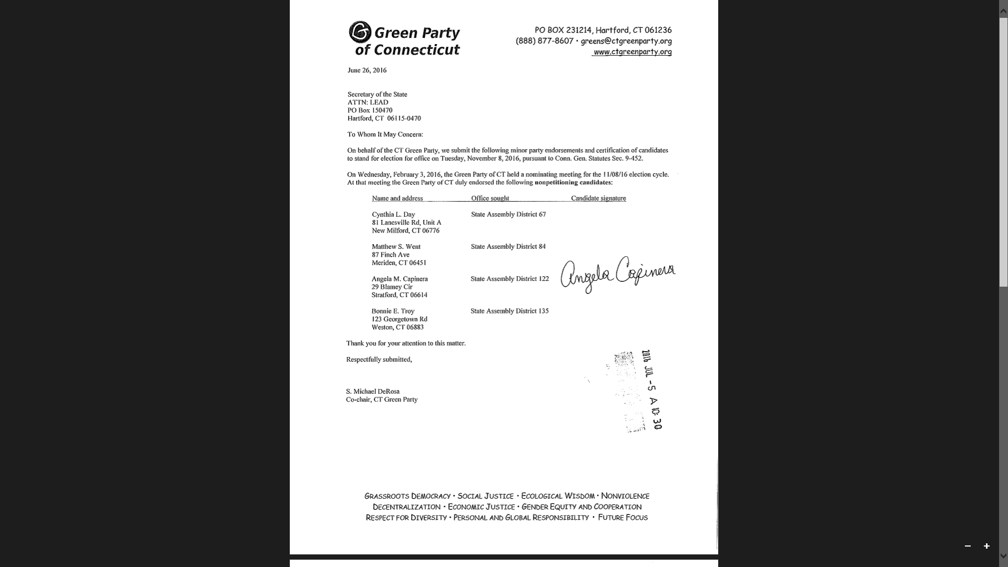
Green Party 2016 Endorsement

Slide 10
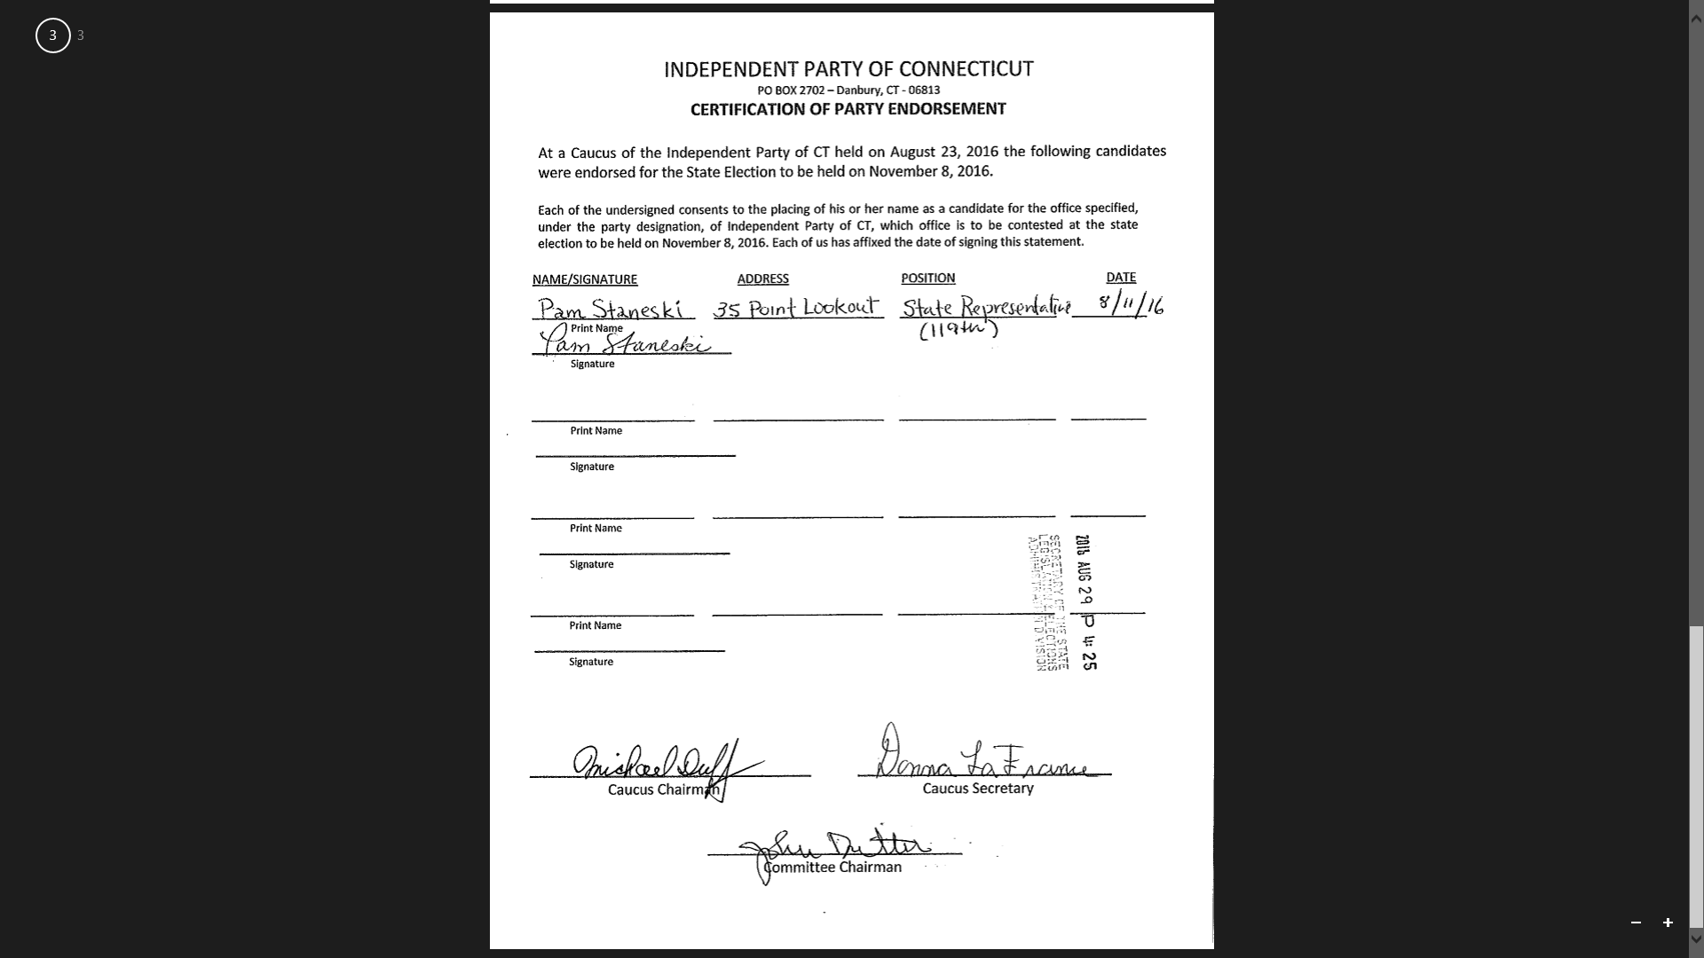
Independent Party 2016 Endorsement

